Slide 1
PESTICIDES & HERBICIDES
Gillian Beauchamp, MD

Slide 2
Pesticides & Herbicides in Thailand
Largest importer of pesticides in SE Asia
Fourth largest user of pesticides in SE Asia
4 fold increase in pesticide use 2002-2012 (Office of Agricultural Economics)
73% of imported pesticides are WHO category 1a (extremely hazardous) or 1b (highly hazardous)
Resurgence of pesticide use due to pest resistance
35-37% of foods grown in Thailand have detectable concentrations of pesticides
86% of water in Thailand has detectable pesticides
http://www.panna.org/
Notes:
Agricultural products = 19% of Thailand’s export value

Slide 3
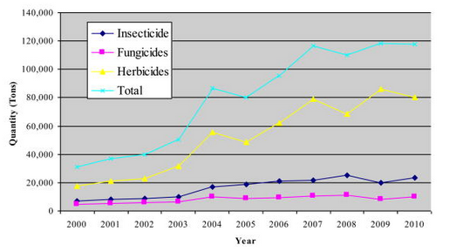
Imported Pesticides in Thailand
2010: 70,000 tons of imported pesticides
Most commonly imported: glyphosate, paraquat and 2,4-D
Panuwet P, Siriwong W, Prapamontol T, et al. Agricultural Pesticide Management in Thailand: Situation and Population Health Risk. Environmental science & policy. 2012;17:72-81. doi:10.1016/j.envsci.2011.12.005.

Slide 4
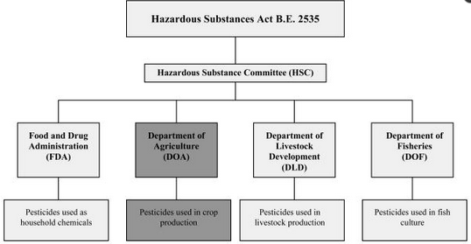
Notes:
Regulatory Body of Hazardous Substance Act B.E. 2535 (1992) amended B.E. 2544 (2001) and B.E. 2551 (2008)

Slide 5
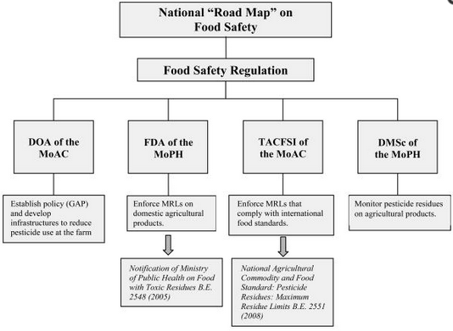

Slide 6
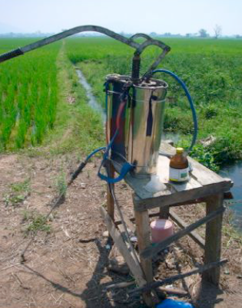

Notes:
Backpack sprayer contains 2,4-D. Note limited protective gear worn despite known potential carcinogenicity

Slide 7
Outline
Insecticides
  Pyrethrins & pyrethroids
  Organochlorines
  Biologicals
  Other insecticides
Herbicides
  Chlorphenoxy herbicides
  Pentachlorophenol & dinitrophenol pesticides
  Paraquat & diquat
  Phosphonate herbicides

Slide 8

Key Principles
Risk = Toxicity X Exposure
Types of Exposures
  Spray drift from pesticide application
  Spills: Manufacture & application
  Suicidal ingestions
  Explosions
  Agricultural run off: drinking water
Ingestion/body weight
No proven teratogenicity
  Associations with low birth weight, cognitive & motor delay, ADHD
Notes:
Children at greater risk of toxicity due to lower body mass; less developed neurologically
Suicidal ingestions of pesticides are one of leading causes of suicidal death worldwide – 60% of suicidal deaths in Asia

Slide 9
Barriers to Recognition and Management
Lack of familiarity with reporting requirements
Misdiagnosis
  Lack of familiarity with pesticide effects
  Misdiagnosis
  Growing interest in environmental medicine training but ongoing need for formal training
Notes:
US: Poison centers; state-based pesticide illness and surveillance programs

Slide 10
Goals
General approach to management of a pesticide exposure
General understanding of pesticide classes and agents

Slide 11
General Approach to Management
Decontamination
  Protective equipment
  Irrigation
History
  Exposure to pesticides, solvents, chemicals, dusts, fumes, radiation, noise
  Product name and label
Testing
  Limited availability
Treatment
  Activated charcoal
  Seizure control
Consultation
  Expert in the field
Follow up
  Primary care provider + employer
Reporting
  Appropriate agency
Notes:
In US: NIOSH, CDC, EPA provide surveillance but no systematic reporting in all states. The EPA accepts reporting and will investigate if there has been a violation of ‘Agricultural Worker protection standard’. OSHA has authority over work place pesticides (only large farms in most states; farms of all sizes in a few states); EPA has authority over home use and work place. OSHA accepts anonymous reporting of pesticide exposures. Mandatory reporting exists for some pesticides. SENSOR: sentinel event notification system for occupational risk – in 11 participating states.
No indication for lavage or cathartics; AC has been used in some pesticide exposures. Concern with exposures with risk of seizure.

Slide 12

Case 1: ‘Bug Bomb’
8 year old female
Rhinitis and wheezing
Mom states she was using a ‘bug fogger’

Slide 13

Pyrethrins: Background
Pyrethrum: oleoresin extract of dried chrysanthemum flowers
Contains pyrethrins = insecticidal
Insect paralytic
Commonly dissolved in hydrocarbon solvent
Unstable in light & heat: used indoors

Slide 14

Pyrethrins: Toxicology
Absorbed in lungs and GI tract
  Minimal skin absorption
Pyrethrum: dermal and respiratory allergen
Rhinitis
Dermatitis
Bronchospasm
Massive exposure: tremor, ataxia, salivation
Hydrocarbon vehicles
  Aspiration pneumonitis
  Myocardial sensitivity

Slide 15

Pyrethrins: Treatment
Treat allergic type symptoms
Antihistamines
Beta agonists
Systemic corticosteroids
Epinephrine
No laboratory testing available

Slide 16
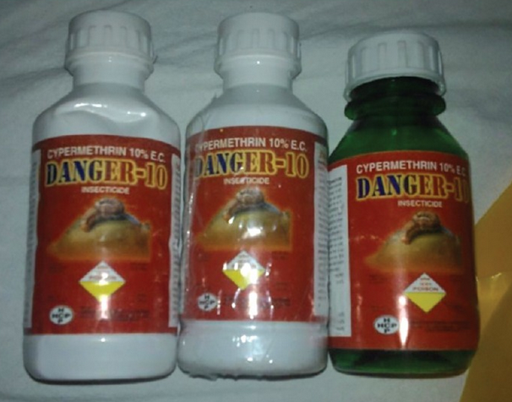
Case 2: A Suicidal Ingestion
30 Year old male
Vomiting and epigastric pain
Throat pain, increased salivation,
Lacrimation
Cough, & dyspnea
300 ml of Danger-10
J Emerg Trauma Shock. 2015 Apr-Jun; 8(2): 123–125.

Slide 17
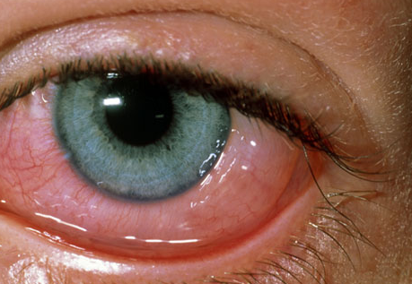
Exam and Course
Conscious, oriented, anxious
Conjunctival injection
Normal pupils
Tremor of hands
Normal vitals
Bilateral rhonchi
Normal labs: CBC, Chemistry
Negative Chest X ray
Treated with albuterol, steroids, IV fluids
Improved 24 hours later

Slide 18
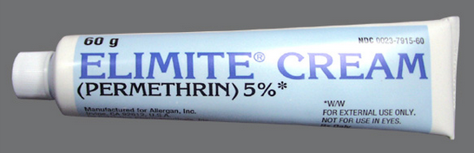

Pyrethroids: Background
Chemically similar to pyrethrins
Synthetic: modified to increase stability in environment
More severe toxic effects than pyrethrins

Slide 19
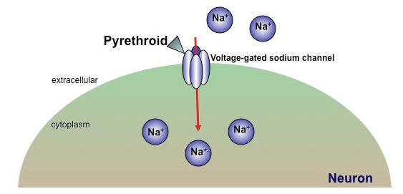
Pyrethroids: Toxicity
Hyperexcitability and repetitive neuronal firing due to Na+ and Cl- channel changes
Na+ channel openers
Decreased chloride currents
GABA inhibition
NE release
Medschool.Creighton.edu

Slide 20
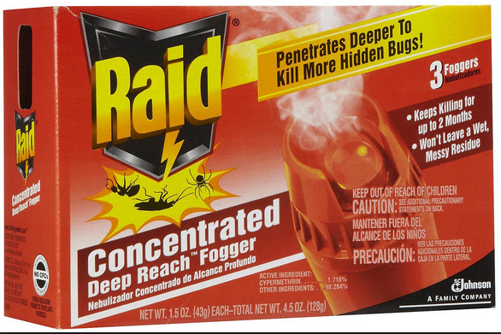
Pyrethroids: Toxicity
Type I: permethrin
  Less severe: dermatitis and ocular irritation
Type II: Contain cyano group
  Cypermethrin, cyfluthrin, allethrin, cismethrin, fluvalinate, deltamethrin & fenvalerate
  More severe effects
  Tremor
  Salivation
  Ataxia
  Choreoathetoid movements
  Vomiting and diarrhea
  Eye irritation
  Weakness
Notes:
This product contains cypermethrin

Slide 21

Pyrethroid: Management
Decontamination: flushing
Ventilation of area
Mask to avoid vapor contact
Activated charcoal if ingestion
Vitamin E oil to manage paresthesias
Testing
  Pyrethroid metabolites can be detected in the urine
  Not routinely available
United States Environmental Protection Agency

Slide 22
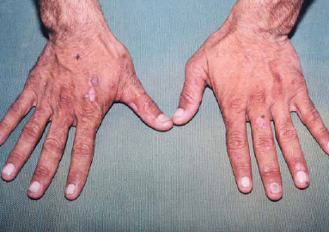
Case 3: ‘Itchy Hands’
29 year old male
Blisters and hyperpigmentation to dorsal surface of bilateral hands
Itching: worse with sunlight
Continues to work in family orchards
Lab work up normal except for histology consistent with porphyria cutanea tarda

Slide 23
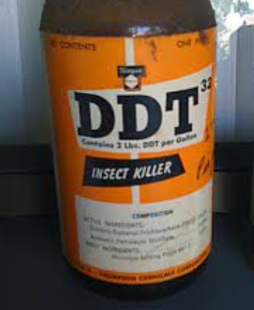
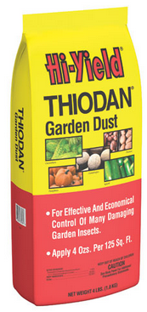
His exposure: DDT & Thiodan
Notes:
Organochlorine exposure: Patient educated to wash all fruit before ingesting: noted to have exposure to DDT and thiodan organochlorines during his life in the orchard. One year follow up: marked improvement in his symptoms.

Slide 24
Similar toxin….Case 4
A male worker presents with muscle pain, weakness, fever, and confusion progressing to tonic-clonic seizure after spraying an insecticide for 10 hours/day over 14 days.
  Ventilatory support
  Seizure treatment
  Recovery in 6 days
Ravindran M. Toxic encephalopathy from chlorobenzilate poisoning: report of a case. Clin Electroencephalogr 1978;9(4):170-172.

Slide 25
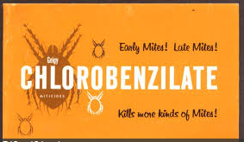
Chlorobenzilate
Organochlorine insecticide used in orchards
Diarrhea, tremor, weakness and ataxia
Seizures and coma
Decontamination with water
Activated charcoal if ingestion
Seizure treatment & supportive care

Slide 26
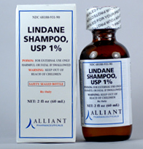
Organochlorines: Background
Many products banned in US
  Still in use: dicofol & endosulfan
Multiple cases of neurotoxicity
  Lindane – no longer recommended for use in children but still in use
Notes:
Lindane: second line agent for lice and scabies treatment: marketed as ‘Kwell’ and ‘Thionex’.

Slide 27
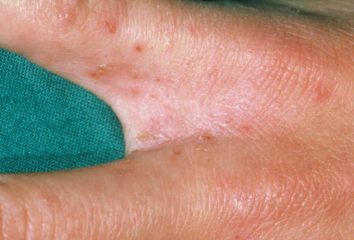
Case Report
A child with severely abraded skin was treated with Lindane for scabies
Developed seizures
Lindane concentration peaked at 6 hours
Friedman SJ. Lindane neurotoxic reaction in nonbullous congenital ichthyosiform erythroderma. Arch Dermatol 1987;123(8): 1056-8.
www.webmd.com

Slide 28
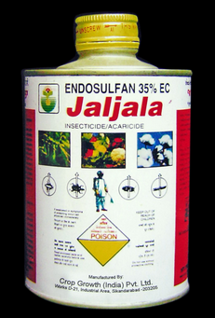
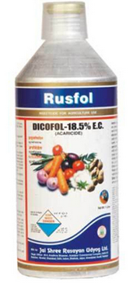
Organochlorines
Efficient absorption across skin
  Hexachlorocyclohexane
  Lindane
  Cyclodienes: Aldrin, dieldrin, endrin, chlordane, heptachlor
  Endosulfan
Less efficiency absorbed (except where skin break down)
  DDT
  Dicofol
  Methoxychlor
  Toxaphene
  mirex
Notes:
Skin breakdown with scabies derm lesions can lead to lindane toxicity – especially in children
DDT (dichlorodiphenyltrichloroethane)

Slide 29
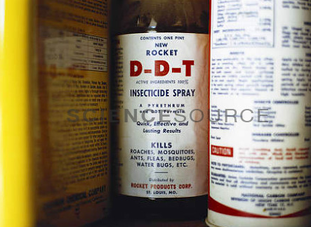
Organochlorines: Toxicity
Lipophilicity: long-term storage in body fat
  DDT, hexachlorocyclohexane, dieldrin, heptachlor epoxide, and mirex
Hydrocarbon solvent: increases absorption
  GI
  Dermal
  Inhalational
Images.sciencesource.com
Notes:
DDT (dichlorodiphenyltrichloroethane)

Slide 30
Organochlorines: Acute Toxicity
Hyperexcitable state
  Myoclonic jerking
  Paresthesias
  Tremor
  Ataxia
  Hyperreflexia
Seizures: Death from respiratory failure & severe acidosis
  Seizures can be delayed up to 48 hours and can recur for several days after exposure
Nausea, vomiting

Slide 31
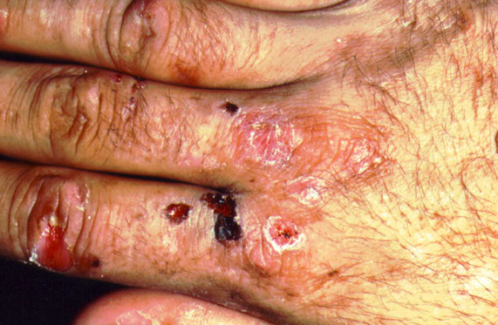
Organochlorines: Chronic Toxicity
Porphyria cutanea tarda – skin damage = scarring and contractures
Hematologic: aplastic & megaloblastic anemia
Suspected carcinogenicity and endocrine dysfunction
Medicalpicturesinfo.com

Slide 32
Organochlorine: Management
Decontamination: water
Activated charcoal if early and protecting airway
Seizures: benzodiazepines
Hydrocarbon vehicle:
  Imaging and monitoring for aspiration pneumonitis
  Risk of myocardial irritability – avoid sympathomimetics
Testing of blood samples – limited availability
DDT, dieldrin, mirex, heptachlor epoxide and chlordecone – may persist for years in adipose tissue + in breast milk
Notes:
Can try contacting poison center to ask about availability of testing: some government, university or private labs

Slide 33
Biologicals
Pesticides of natural origin
Used because they are less toxic to mammals than to pests
For many, toxicity is mild
Risks of treatment may outweigh benefits

Slide 34
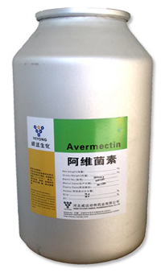
Avermectin
Derived from soil bacterium Steptomyces avermitilis
Used to control mites and fire ants (ant bait stations)
GABAergic: inhibit nerve conduction to muscles
Mild: salivation, vomiting and diarrhea
Severe: respiratory failure, hypotension and coma
Toxic in large ingestions (over 40 mg/kg)
Treatment: Decontamination and activated charcoal

Slide 35
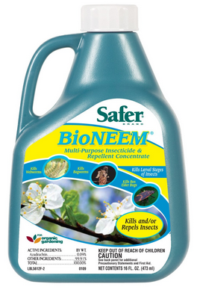
Azadirachtin
Obtained from neem tree (Azadirachta indica)
Manufactured in India
Insect growth inhibitor
Interferes with molting hormone ecdysone
Dermal and GI irritation
CNS depression
Tx: Decon
Avoid AC due to GI irritation and CNS depression

Slide 36
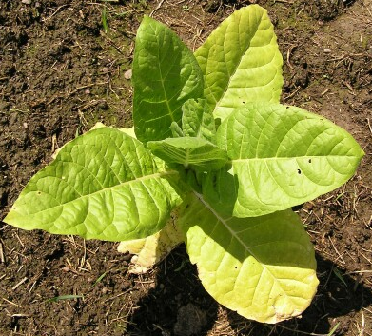
Nicotine
Alkaloid obtained from tobacco plant
Absorbed by gut, lung, & skin
Blockade of autonomic ganglia and skeletal muscle NMJ
Paralysis & cardiovascular collapse
M: Mydriasis
T: Tachycardia
W: Weakness
tH: Hypertension
F: Fasiculations
Treatment: Decontamination & supportive care

Slide 37

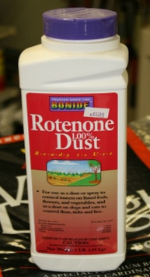
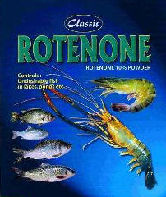
Rotenone
Plant-derived
Neurotoxic to insects & fish
Also used to kill fish in lakes & ponds
Oral and respiratory tract irritation
Dermatitis
Peripheral neuropathy
Tx: Decontamination & activated charcoal
Notes:
Complaints mostly in workers with occupational exposure

Slide 38
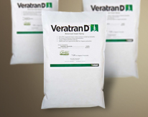
Sabadilla (Veratrum Alkaloid)
Powdered ripe lily seeds
Pesticide applied to citrus fruit, avocados, and mangos
Respiratory irritant: sneezing
Skin irritant
Sodium channel opener
Bradycardia & salivation: Atropine
Hypotension: IVF
Weakness
Tx: Decontamination & activated charcoal

Slide 39
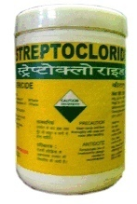
Streptomycin
Antibiotic derived from growth of Streptomyces griseus
Used for control of bacterial plant pathogens
Shares toxic profile with human aminoglycosides
  Ototoxicity
  Nephrotoxicity
Tx: Decon and supportive care

Slide 40
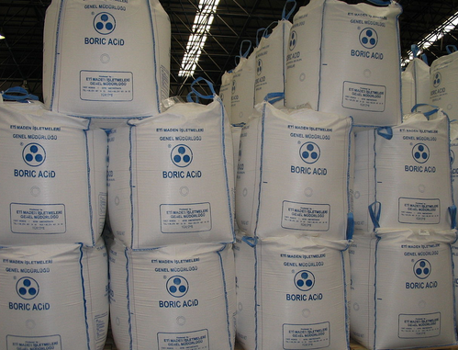
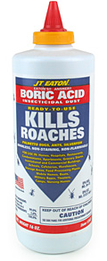
Other Insecticides: Boric Acid and Borates
Larvae and cockroach insecticides
Well-absorbed by the gut or abraded skin
Pediatric patients at risk: powder or pellets on floor
Chronic exposure: Borate plant workers – pulmonary irritant
Ingestion: vomiting, diarrhea and ‘beefy red exfoliative rash’
Seizure, coma, shock leads to renal failure + acidosis → death
Notes:
Toxicity has developed with boric acid use as diaper rash or burn treatment

Slide 41
Boric Acid and Borates: Treatment
Testing: borate concentrations available (normal is < 0.2 mg/dL) but concentrations vary with toxicity – unreliable in guiding treatment
Decontamination: irrigate skin & eyes
Activated charcoal: may be limited by GI symptoms
Aggressive resuscitation: IV fluid + vasopressors
Seizures: benzodiazepines
Dialysis: has been used for renal failure and to remove boric acid

Slide 42
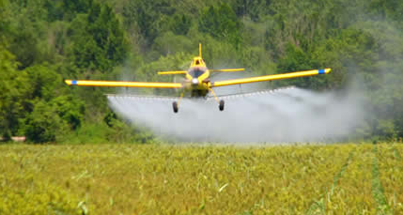
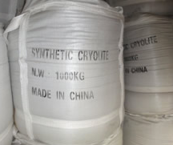
Other Insecticides: Fluorides
Crystalline mineral
Used on homes & warehouses – crawling insects
Sodium fluosilicate & Sodium fluoaluminate (Cryolite)
Readily absorbed from GI tract – peak effects in 30 minutes
Rapidly bind Ca, Mg → tetany & cardiac toxicity
Diagnosis: history + hypocalcemia, hypomagnesemia, hyperkalemia
Tx: Decontamination
NO Activated charcoal: won’t bind fluoride
Oral calcium, IV calcium & magnesium + aggressive resuscitation

Slide 43
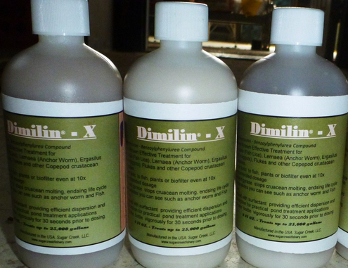
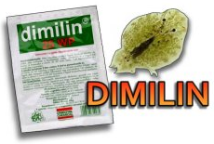
Other Insecticides: Haloaromatic Substituted Urea Insecticides
Impair chitin deposition in the larval exoskeleton
Diflubenzuron & Teflubenzuron
Decontamination: water
Aniline metabolites cause methemoglobinemia

Slide 44
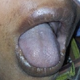
Quiz
43 year old female works in an animal feedlot where ‘Dimilin’ is being used to reduce a large fly population.
She reports the accidental ingestion of a cup of the agent while eating lunch in the work place.
SpO2 85% + perioral cyanosis
MetHb is 30%
What is the treatment for methemoglobinemia?

Slide 45
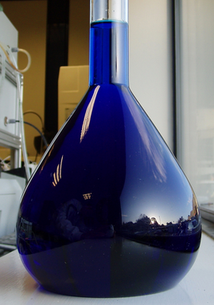
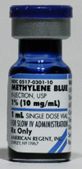
Answer: Methylene Blue
Provided as a 1% solution (10 mg/mL).
The dose is 1 to 2 mg/kg (0.2 mL/kg of a 1% solution) infused intravenously over 3 to 5 minutes.
Repeat at 1 mg/kg if MHb does not resolve within 30 minutes.
Methylene blue should reduce MHb levels significantly in less than an hour

Slide 46
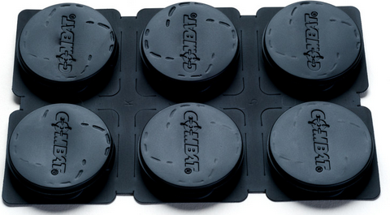
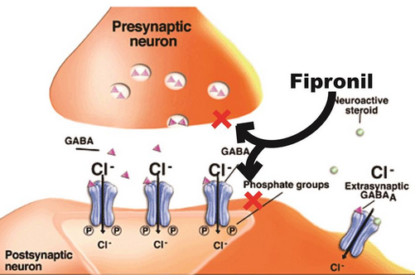

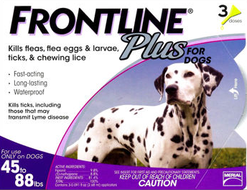
Other Insecticides: N-phenylpyrazone Insecticides
Example: fipronil
Used on lawns, crops
Bait stations: ants, cockroach
Tick and flea control for pets
GABA-antagonist: hyperexcitability
Self-limited vomiting followed by AMS & seizures for several hours
64% of US poisonings: pediatric exposure to pet medications
Treatment: benzodiazepines

Slide 47

Case 5: A fatality
69 year old female
AMS, vomiting, diaphoresis
30 minutes after ingestion of about 200 mL imidacloprid
170/73 mm Hg, T 35°C, 117 bpm, 24 breaths/min
Multiple erythematous ulcers over the oropharynx
ECG: sinus tachycardia
Chest x-ray normal
CK and troponin normal
Activated charcoal + lavage
At 1 hour: V Fib
Tx: IV fluid, amiodarone, dopamine, defibrillation
Death in ICU at 12 hours
Huang NC et al. Fatal ventricular fibrillation in a patient with acute imidacloprid poisoning. Am J Emerg Med 2006;24(7):883-5.
Notes:
NMP: irritant to mucosa and lungs

Slide 48
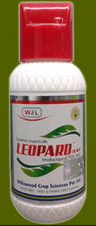
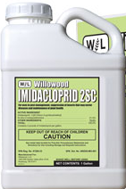

Neonicotinoid Insecticides
Developed in 1980s
Used for crop-damaging insects
Imidacloprid
Developed from nicotine
Absorbed by plant – migrate to surface and affect piercing insects
Displace ACh from the nicotinic ACh receptors
Nicotine poisoning + solvent irritant effects
Notes:
Other examples: clothianidin and thiamethoxan, dinoterfuran

Slide 49
Quiz: What are the expected effects of nicotinoid toxicity?
Hint:
M:
T:
W:
H:
F:

Slide 50
Quiz: What are the expected effects of nicotinoid toxicity?
M: Mydriasis
T: Tachycardia
W: Weakness
H: Hypertension
F: Fasiculations

Slide 51
Neonicotinoid: Toxicity
Vomiting, diarrhea
GI irritation/corrosion: solvent effects
Confusion
Tremor
Imidoclopid toxicity also causes:
Aspiration pneumonia & respiratory failure
Rhabdomyolysis and renal failure
Testing of serum sample not widely available
Treatment: Activated charcoal + supportive care

Slide 52

HERBICIDES
Chlorphenoxy herbicides
Pentachlorophenol and dinitrophenol pesticides
Paraquat and diquat
Phosphonate herbicides

Slide 53

Chlorphenyoxy Herbicides: Background
2,4-D (dichlorophenoxyacetic acid)
2,4,5-T (trichlorophenoxy acid)
MCPP (Mecoprop)
MCPA (4-chloro-2-methyl-phenoxyacetic acid)
Severe acute exposures with ingestion
Chronic exposures with application or manufacturing

Slide 54
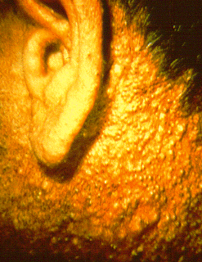
Chlorphenoxy Herbicides: Toxicity
Mild exposure: headache, weakness, abdominal pain + nausea
Large ingestion: agitation, vomiting + diarrhea
Myotoxic: metabolic acidosis, rhabdomyolysis
Uncouplers of oxidative-phosphorylation
  Hyperthermia , acidosis + multi-organ failure
Chloracne: in manufacturers and herbicide applicators – due to dioxins formed in manufacturing process.
Chronic exposures: muscle weakness (myopathy on EMG) and peripheral neuropathy (abnormal nerve conduction studies)
Notes:
Labs: acidosis, elevated CK, myoglobinuria, renal failure, liver failure (multi-organ failure)

Slide 55
Chlorphenoxy Herbicides: Management
Testing: urine performed within 24 hours (before urinary excretion completed)
Decontamination: water or soap/water
Activated charcoal
Fluid resuscitation
Can consider urinary alkalinization for renal clearance (400 fold increase in urinary excretion) – data equivocal
Electrolyte repletion
Follow up: Electromyography and nerve conduction studies as an outpatient
Prevention: respiratory protection for workers
Notes:
Urine testing is GC/MS – gas chromatography/mass spectroscopy

Slide 56
Pentachlorophenol (PCP): Background
Herbicide, algaecide, wood preservative, germicide, fungicide and molluscicide
Absorbed across skin, lungs and GI tract
Mechanism of action: Un-coupler of oxidative phosphorylation

Slide 57
Pentachlorophenol (PCP): Toxicity
Hyperthermia + diaphoresis
Multi-system organ failure and rhabdomyolysis
Pregnant women: increased risk of miscarriage and low birth weight
Irritant: conjunctivitis, rhinitis, pharyngitis
Chloracne (~7% of manufacturing workers) – due to contamination with dibenzodioxans, chlorinated dibenzofurans, and hexachlorobenzene – due to manufacturing process
Probable human carcinogen: aplastic anemia and leukemia
Possible association with peripheral neuropathy with chronic exposure
Notes:
Both carcinogenicity and association with peripheral neuropathy with limited data: no causal relationship is supported by longitudinal studies.

Slide 58
Dinitrophenolic Pesticides
Even more active uncoupler than PCP
Yellow staining of skin and hair

Slide 59
PCP & DNP: Management
Plasma or urine testing
Plasma: urine concentrations 2.5:1
Decontamination: water or soap/water
Fluid resuscitation
Hyperthermia: Aggressive cooling (no antipyretics) + sedation
Replete electrolytes
Notes:
No good data on correlation of concentration with clinical findings

Slide 60
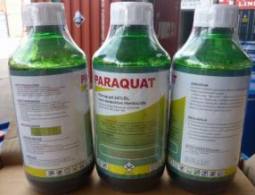
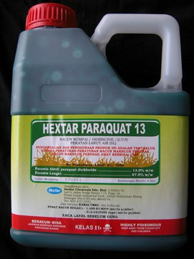
Dipyridyl Herbicides: Paraquat
Generates free radicals that cause oxidative damage to tissues
  Lipid peroxidation
  Cell injury
  Affects types I and II pneumocytes
Pulmonary toxicity dominates
Acute pulmonary edema within a few hours
Delayed pulmonary fibrosis resulting in death 7-14 days after ingestion
Contact dermatitis and ulceration of GI tract
Hepatotoxicity
Renal toxicity: further delays elimination

Slide 61
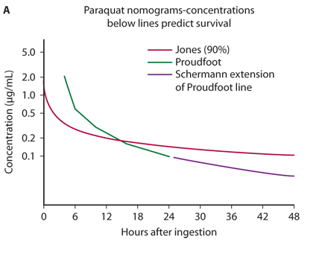
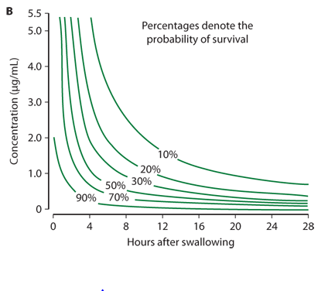
Paraquat: Clinical toxicity
Notes:
< 20 mg/kg: self-limited GI symptoms
20-40 mg/kg: Pulmonary fibroplasia – death may be delayed 2-3 weeks
> 40 mg/kg: Oropharyngeal ulceration, multi-organ failure and 100% mortality within 7 days
Hart paraquat nomogram.³⁶ In A, concentrations below lines predict survival. In B, lines link concentrations of equal probability of survival.

Slide 62
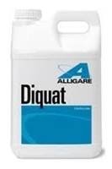
Diquat: Toxicology
CNS toxicity predominates
Irritability, confusion → tonic clonic seizures → coma and death
Early corrosive effects: mouth and GI tract
Early GI symptoms → renal failure (worsens excretion) → shock and death

Slide 63
Dipyridyl Poisoning: Management
Colorimetric test to detect paraquat and diquat in urine
Dithionate test:
  Blue = paraquat
  Green = diquat
Blood and urine testing also available
Fluid resuscitation
Pain control
Skin decontamination: water
GI decontamination: adsorbents
  AC
  Bentonite: 100-150 gram PO
  Fuller’s Earth: 100-150 gram PO
Paraquat
Lung imaging for paraquat:
  < 20% ground glass opacities = survivable
  > 40% = 100% mortality
Paraquat: Do not apply oxygen unless severe hypoxia – given free radical pathophysiology
Methylprednisolone and cyclophosphamide have been effective in reducing mortality in some studies, ineffective in others
Notes:
Lung transplants may be susceptible to damage due to redistribution of paraquat.

Slide 64
Quick Review
Paraquat
Lung toxicity
Avoid oxygenation
Diquat
Nervous system toxicity
Renal failure
Both Paraquat and Diquat:
Early GI irritant effects with vomiting and diarrhea
Renal elimination, so renal failure and shock worsens toxicity

Slide 65
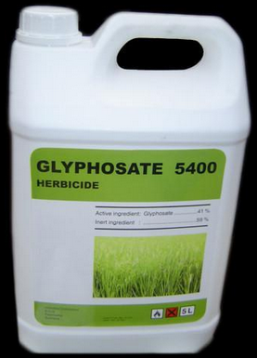
Phosphonate Herbicides
Glyphosate
Inhibits the plant-specific enzyme responsible for synthesizing phenylalanine, tyrosine and tryptophan
Combined with organic surfactant

Slide 66
Glyphosate: Toxicity
Early mouth and throat pain
Vomiting and diarrhea
Cardiovascular collapse
Respiratory failure with severe ingestions
Seizures
Decontamination: water
Supportive care
Dialysis may be needed for renal failure
Seizures: benzodiazepines

Slide 67
Quiz: Match the pesticide or herbicide with its characteristic
Pyrethrins
Pyrethroids
Organochlorines
Streptomycin
Fluoride-based pesticides
Dinitrophenolic herbicides
Paraquat
A. Delayed lung toxicity
B. Hypocalcemia
C. Uncoupling of oxidative phosphorylation
D. Allergic type symptoms: treat with antihistamines
E. Tremor, ataxia, choreoathetoid movements
F. Porphyria cutanea tarda & hyperexcitability
G. Ototoxicity & nephrotoxicity

Slide 68
Quiz: Match the pesticide or herbicide with its characteristic
Pyrethrins
Pyrethroids
Organochlorines
Streptomycin
Fluoride-based pesticides
Dinitrophenolic herbicides
Paraquat
A. Delayed lung toxicity
B. Hypocalcemia
C. Uncoupling of oxidative phosphorylation
D. Allergic type symptoms: treat with antihistamines
E. Tremor, ataxia, choreoathetoid movements
F. Porphyria cutanea tarda & hyperexcitability
G. Ototoxicity & nephrotoxicity

Slide 69
Quiz: Match the pesticide or herbicide with its characteristic
Pyrethrins
Pyrethroids
Organochlorines
Streptomycin
Fluoride-based pesticides
Dinitrophenolic herbicides
Paraquat
A. Delayed lung toxicity
B. Hypocalcemia
C. Uncoupling of oxidative phosphorylation
D. Allergic type symptoms: treat with antihistamines
E. Tremor, ataxia, choreoathetoid movements
F. Porphyria cutanea tarda & hyperexcitability
G. Ototoxicity & nephrotoxicity

Slide 70
Quiz: Match the pesticide or herbicide with its characteristic
Pyrethrins
Pyrethroids
Organochlorines
Streptomycin
Fluoride-based pesticides
Dinitrophenolic herbicides
Paraquat
A. Delayed lung toxicity
B. Hypocalcemia
C. Uncoupling of oxidative phosphorylation
D. Allergic type symptoms: treat with antihistamines
E. Tremor, ataxia, choreoathetoid movements
F. Porphyria cutanea tarda & hyperexcitability
G. Ototoxicity & nephrotoxicity

Slide 71
Quiz: Match the pesticide or herbicide with its characteristic
Pyrethrins
Pyrethroids
Organochlorines
Streptomycin
Fluoride-based pesticides
Dinitrophenolic herbicides
Paraquat
A. Delayed lung toxicity
B. Hypocalcemia
C. Uncoupling of oxidative phosphorylation
D. Allergic type symptoms: treat with antihistamines
E. Tremor, ataxia, choreoathetoid movements
F. Porphyria cutanea tarda & hyperexcitability
G. Ototoxicity & nephrotoxicity

Slide 72
Quiz: Match the pesticide or herbicide with its characteristic
Pyrethrins
Pyrethroids
Organochlorines
Streptomycin
Fluoride-based pesticides
Dinitrophenolic herbicides
Paraquat
A. Delayed lung toxicity
B. Hypocalcemia
C. Uncoupling of oxidative phosphorylation
D. Allergic type symptoms: treat with antihistamines
E. Tremor, ataxia, choreoathetoid movements
F. Porphyria cutanea tarda & hyperexcitability
G. Ototoxicity & nephrotoxicity

Slide 73
Quiz: Match the pesticide or herbicide with its characteristic
Pyrethrins
Pyrethroids
Organochlorines
Streptomycin
Fluoride-based pesticides
Dinitrophenolic herbicides
Paraquat
A. Delayed lung toxicity
B. Hypocalcemia
C. Uncoupling of oxidative phosphorylation
D. Allergic type symptoms: treat with antihistamines
E. Tremor, ataxia, choreoathetoid movements
F. Porphyria cutanea tarda & hyperexcitability
G. Ototoxicity & nephrotoxicity

Slide 74
Quiz: Match the pesticide or herbicide with its characteristic
Pyrethrins
Pyrethroids
Organochlorines
Streptomycin
Fluoride-based pesticides
Dinitrophenolic herbicides
Paraquat
A. Delayed lung toxicity
B. Hypocalcemia
C. Uncoupling of oxidative phosphorylation
D. Allergic type symptoms: treat with antihistamines
E. Tremor, ataxia, choreoathetoid movements
F. Porphyria cutanea tarda & hyperexcitability
G. Ototoxicity & nephrotoxicity

Slide 75
Quiz: Match the pesticide or herbicide with its characteristic
Pyrethrins
Pyrethroids
Organochlorines
Streptomycin
Fluoride-based pesticides
Dinitrophenolic herbicides
Paraquat
A. Delayed lung toxicity
B. Hypocalcemia
C. Uncoupling of oxidative phosphorylation
D. Allergic type symptoms: treat with antihistamines
E. Tremor, ataxia, choreoathetoid movements
F. Porphyria cutanea tarda & hyperexcitability
G. Ototoxicity & nephrotoxicity

Slide 76
Quiz: Match the pesticide or herbicide with its characteristic
Pyrethrins
Pyrethroids
Organochlorines
Streptomycin
Fluoride-based pesticides
Dinitrophenolic herbicides
Paraquat
A. Delayed lung toxicity
B. Hypocalcemia
C. Uncoupling of oxidative phosphorylation
D. Allergic type symptoms: treat with antihistamines
E. Tremor, ataxia, choreoathetoid movements
F. Porphyria cutanea tarda & hyperexcitability
G. Ototoxicity & nephrotoxicity

Slide 77
Quiz: Match the pesticide or herbicide with its characteristic
Pyrethrins
Pyrethroids
Organochlorines
Streptomycin
Fluoride-based pesticides
Dinitrophenolic herbicides
Paraquat
A. Delayed lung toxicity
B. Hypocalcemia
C. Uncoupling of oxidative phosphorylation
D. Allergic type symptoms: treat with antihistamines
E. Tremor, ataxia, choreoathetoid movements
F. Porphyria cutanea tarda & hyperexcitability
G. Ototoxicity & nephrotoxicity

Slide 78
Quiz: Match the pesticide or herbicide with its characteristic
Pyrethrins
Pyrethroids
Organochlorines
Streptomycin
Fluoride-based pesticides
Dinitrophenolic herbicides
Paraquat
A. Delayed lung toxicity
B. Hypocalcemia
C. Uncoupling of oxidative phosphorylation
D. Allergic type symptoms: treat with antihistamines
E. Tremor, ataxia, choreoathetoid movements
F. Porphyria cutanea tarda & hyperexcitability
G. Ototoxicity & nephrotoxicity

Slide 79
Quiz: Match the pesticide or herbicide with its characteristic
Pyrethrins
Pyrethroids
Organochlorines
Streptomycin
Fluoride-based pesticides
Dinitrophenolic herbicides
Paraquat
A. Delayed lung toxicity
B. Hypocalcemia
C. Uncoupling of oxidative phosphorylation
D. Allergic type symptoms: treat with antihistamines
E. Tremor, ataxia, choreoathetoid movements
F. Porphyria cutanea tarda & hyperexcitability
G. Ototoxicity & nephrotoxicity

Slide 80
Quiz: Match the pesticide or herbicide with its characteristic
Pyrethrins
Pyrethroids
Organochlorines
Streptomycin
Fluoride-based pesticides
Dinitrophenolic herbicides
Paraquat
A. Delayed lung toxicity
B. Hypocalcemia
C. Uncoupling of oxidative phosphorylation
D. Allergic type symptoms: treat with antihistamines
E. Tremor, ataxia, choreoathetoid movements
F. Porphyria cutanea tarda & hyperexcitability
G. Ototoxicity & nephrotoxicity

Slide 81
Quiz: Match the pesticide or herbicide with its characteristic
Pyrethrins
Pyrethroids
Organochlorines
Streptomycin
Fluoride-based pesticides
Dinitrophenolic herbicides
Paraquat
A. Delayed lung toxicity
B. Hypocalcemia
C. Uncoupling of oxidative phosphorylation
D. Allergic type symptoms: treat with antihistamines
E. Tremor, ataxia, choreoathetoid movements
F. Porphyria cutanea tarda & hyperexcitability
G. Ototoxicity & nephrotoxicity

Slide 82

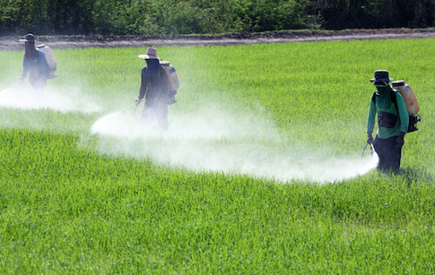
ANY QUESTIONS?

